Slide 1
Online Quiz Application: QuizMaster
FRONT-END WEB DEVELOPMENT
INTERNSHIP PROJECT
Presented By:
1. Janmejay Pandya - LDRP - ITR , COMPUTER ENGINEERING

Slide 2
OUTLINE
Problem Statement
System Development Approach (Technology Used)
Algorithm & Deployment (Step by Step Procedure)
Result
Conclusion
Future Scope
References
IBM Certifications

Slide 3
PROBLEM STATEMENT
Students and educators often face difficulties in finding lightweight, user-friendly, and interactive quiz platforms for practice and assessment.
Existing tools are either too complex, lack customization, or fail to provide engaging interfaces.
Many quiz applications do not offer instant feedback, detailed analytics, or performance tracking, which limits their usefulness in improving learning outcomes.
There is a clear need for a responsive, customizable, and easy-to-use quiz application that enhances both teaching and self-learning by providing immediate scoring, progress tracking, and actionable insights.

Slide 4
SYSTEM APPROACH
Frontend Technologies Used:
HTML5 → Structure and layout of quiz interface.
CSS3 → Responsive design, glass-morphism styling, gradients, and animations.
JavaScript (ES6+) → Core logic for questions, timer, scoring, and interactivity.
Fetch API → Integration with Open Trivia DB for dynamic questions.
Design Approach:
Responsive Design → Works seamlessly on desktops, tablets, and mobiles.
Glass-morphism UI → Modern, engaging look with smooth transitions.
Interactive UX → Hover effects, progress tracking, and real-time feedback.
Accessibility Considerations → Proper contrast, semantic markup, and keyboard navigation.

Slide 5
ALGORITHM & DEPLOYMENT
Step-by-Step Procedure:
1. Quiz Setup: User selects category, difficulty level, number of questions, and timer.
2. Question Retrieval: Fetch questions dynamically from Open Trivia DB API using Fetch API.
3. Quiz Execution: Display questions one by one with multiple-choice options.
Start real-time countdown timer with visual warnings.
Highlight correct/incorrect answers instantly.
4. Scoring & Analytics:Track correct answers, time taken, and accuracy per question.
Calculate total score and generate detailed results.
5. Result Display:Show performance summary (score, accuracy, average time).
Provide insights for improvement.
6. Error Handling & Loading States:Handle API errors, invalid inputs, and loading indicators.

Slide 6
ALGORITHM & DEPLOYMENT
Deployment:
Hosted using GitHub Pages / Netlify for easy online access.
Supports cross-browser compatibility and mobile responsiveness.

Slide 7
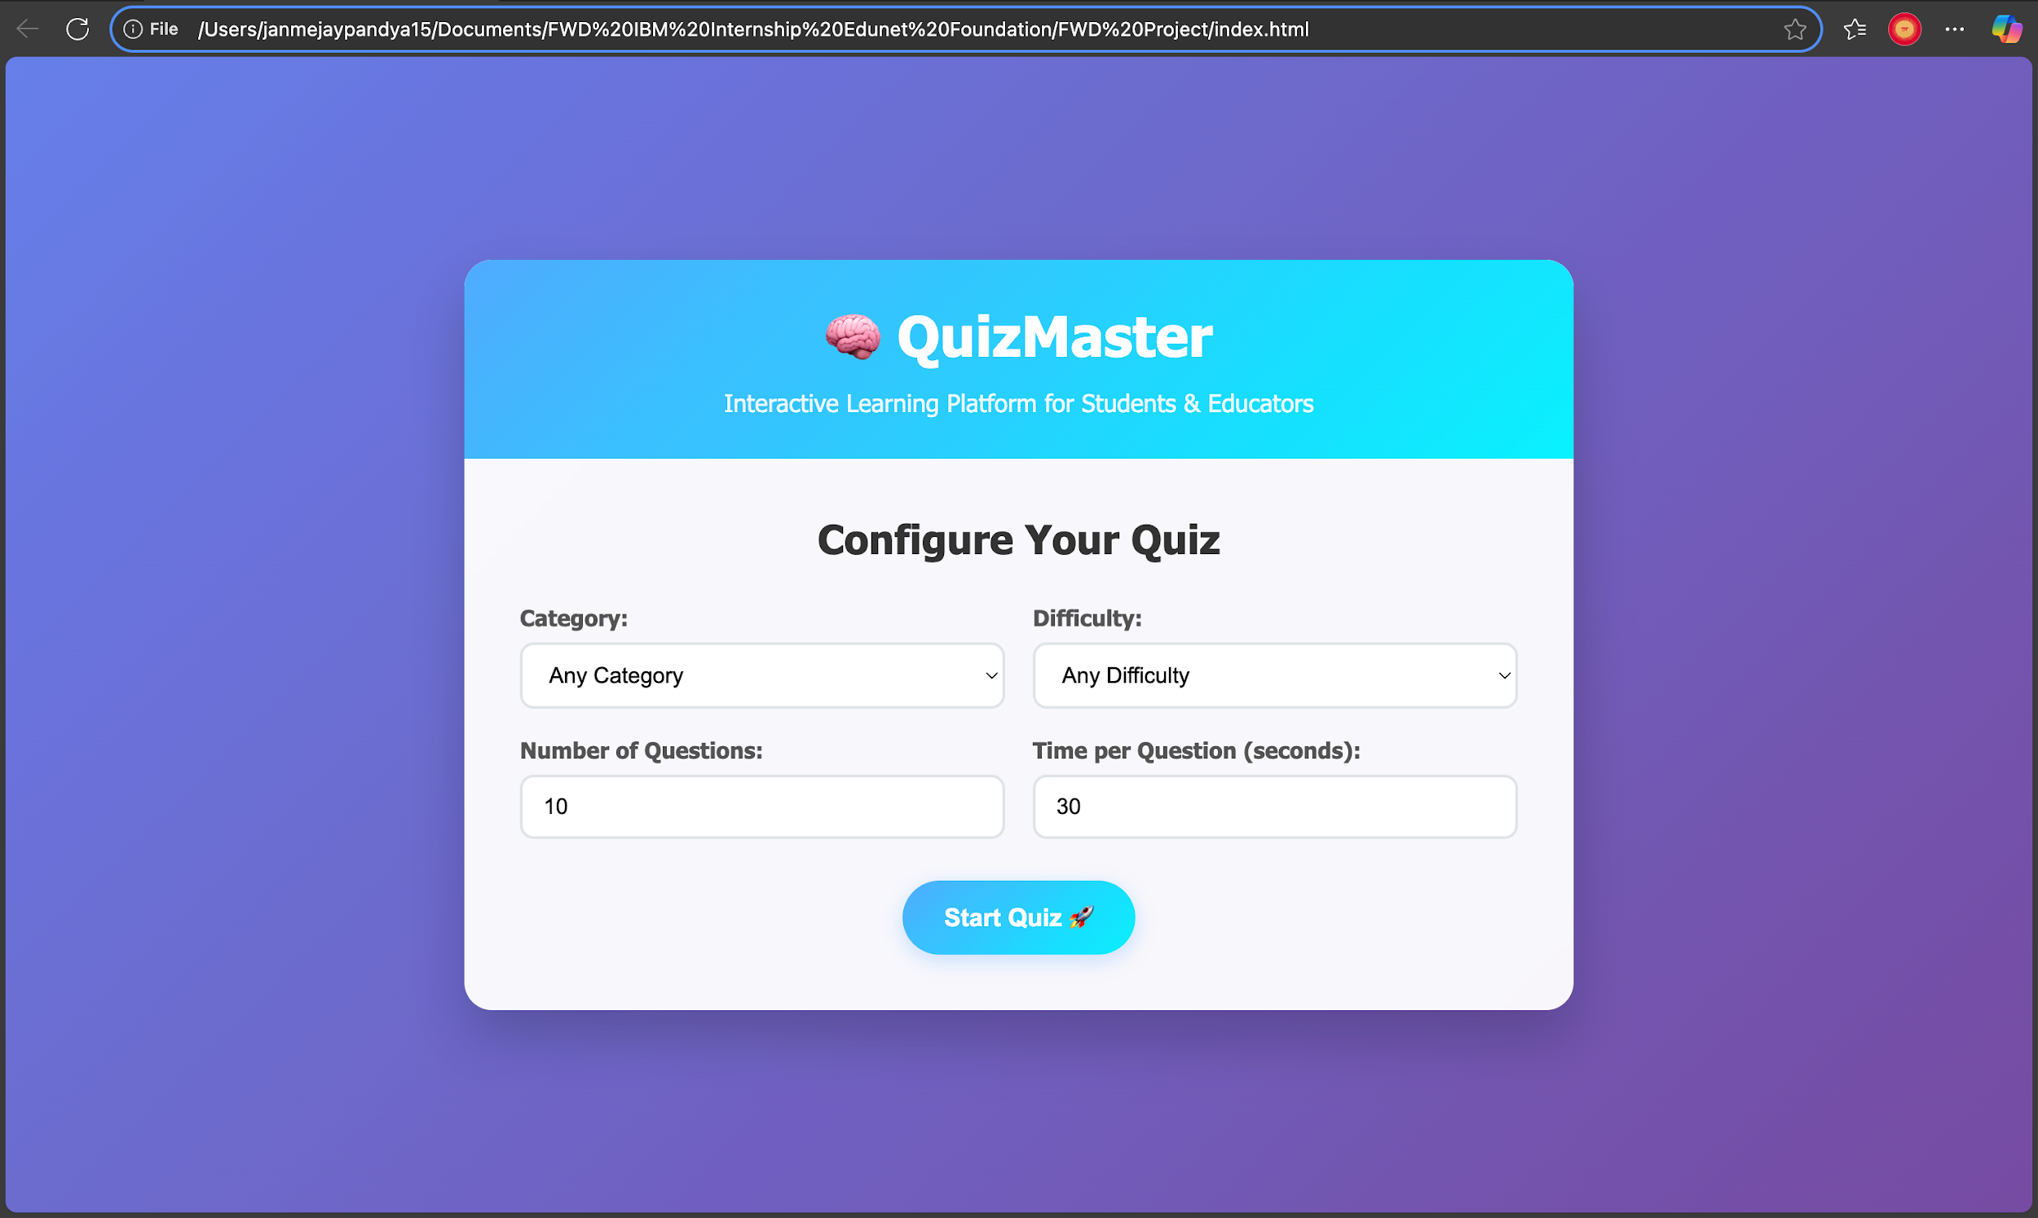
RESULT
Quiz Homepage

Slide 8
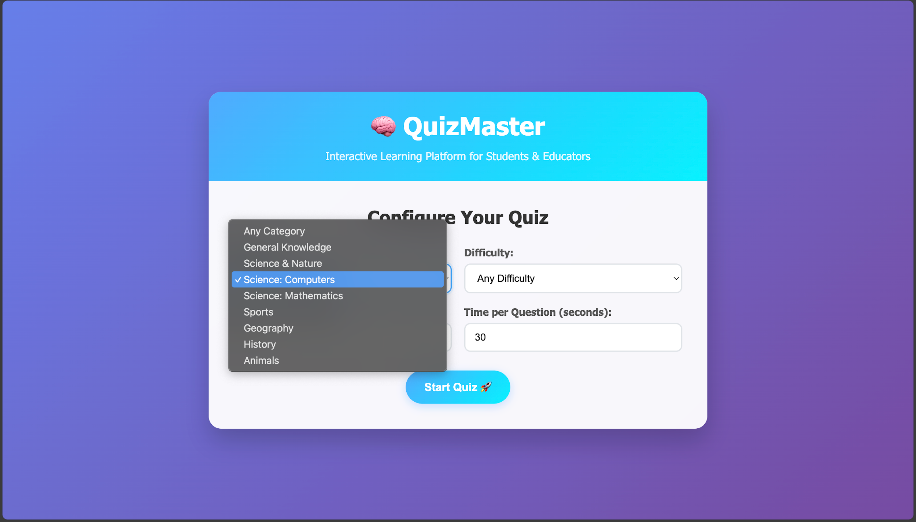
RESULT
2. Select Questions Category

Slide 9
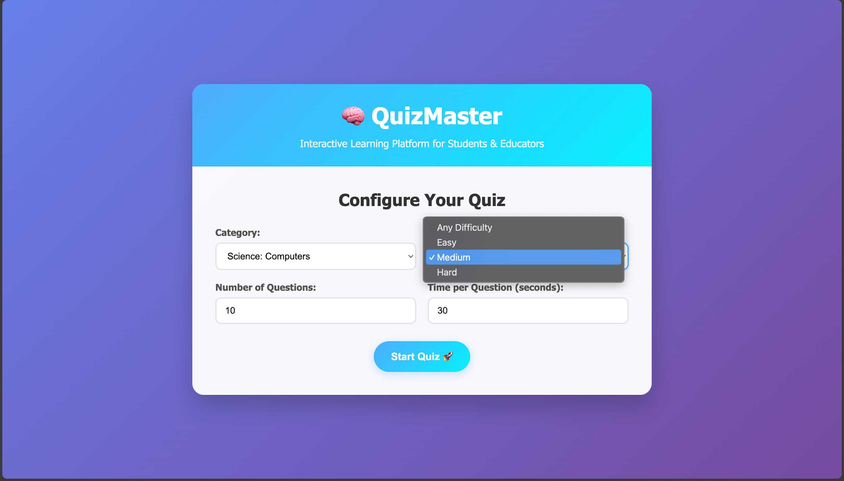
RESULT
3. Select Questions Difficulty Level

Slide 10
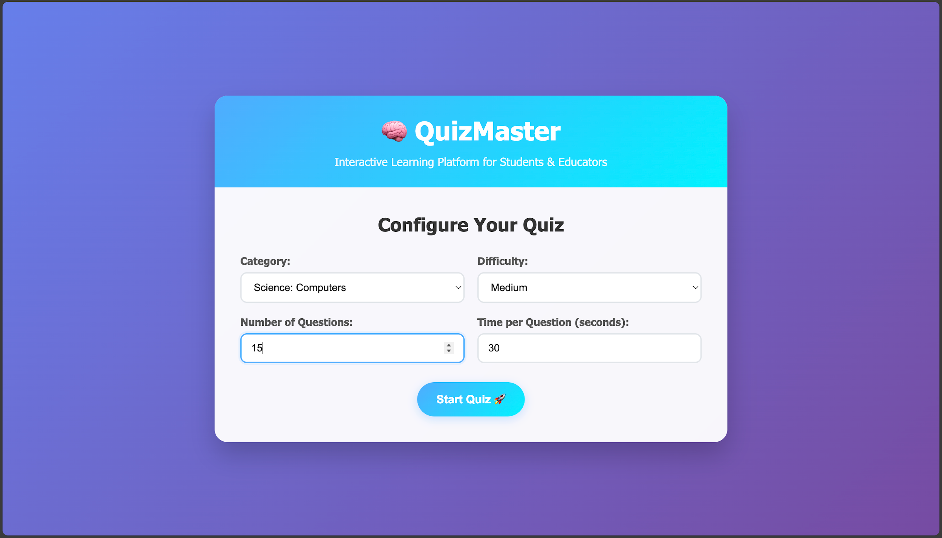
RESULT
4. Select Number of Questions

Slide 11
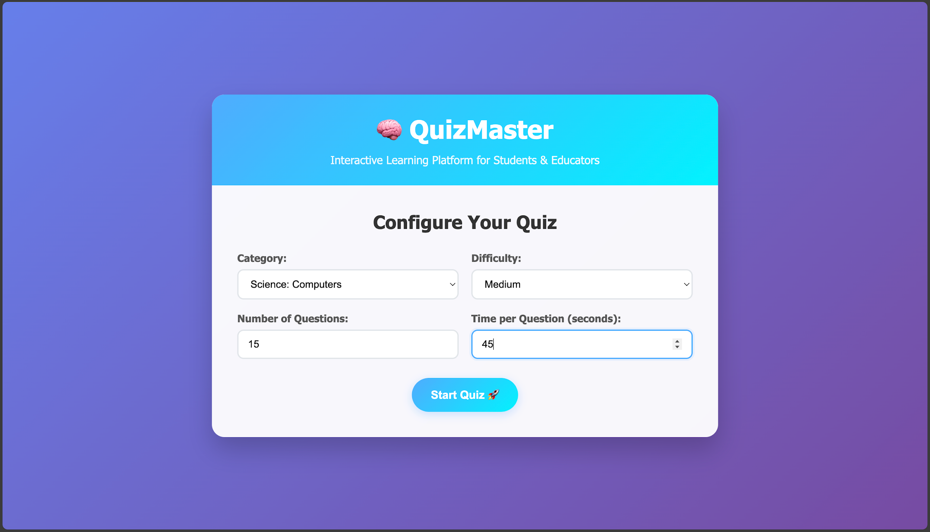
RESULT
5. Select Time Per Question

Slide 12
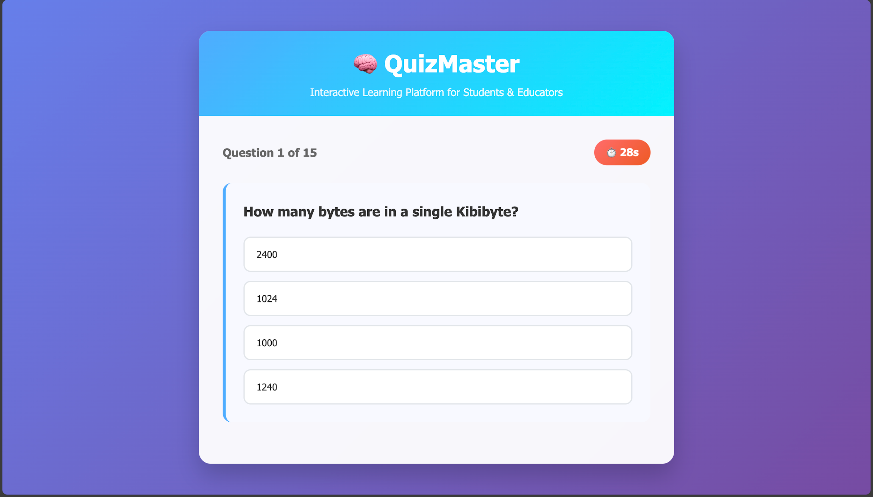
RESULT
6. Quiz Started with Timer

Slide 13
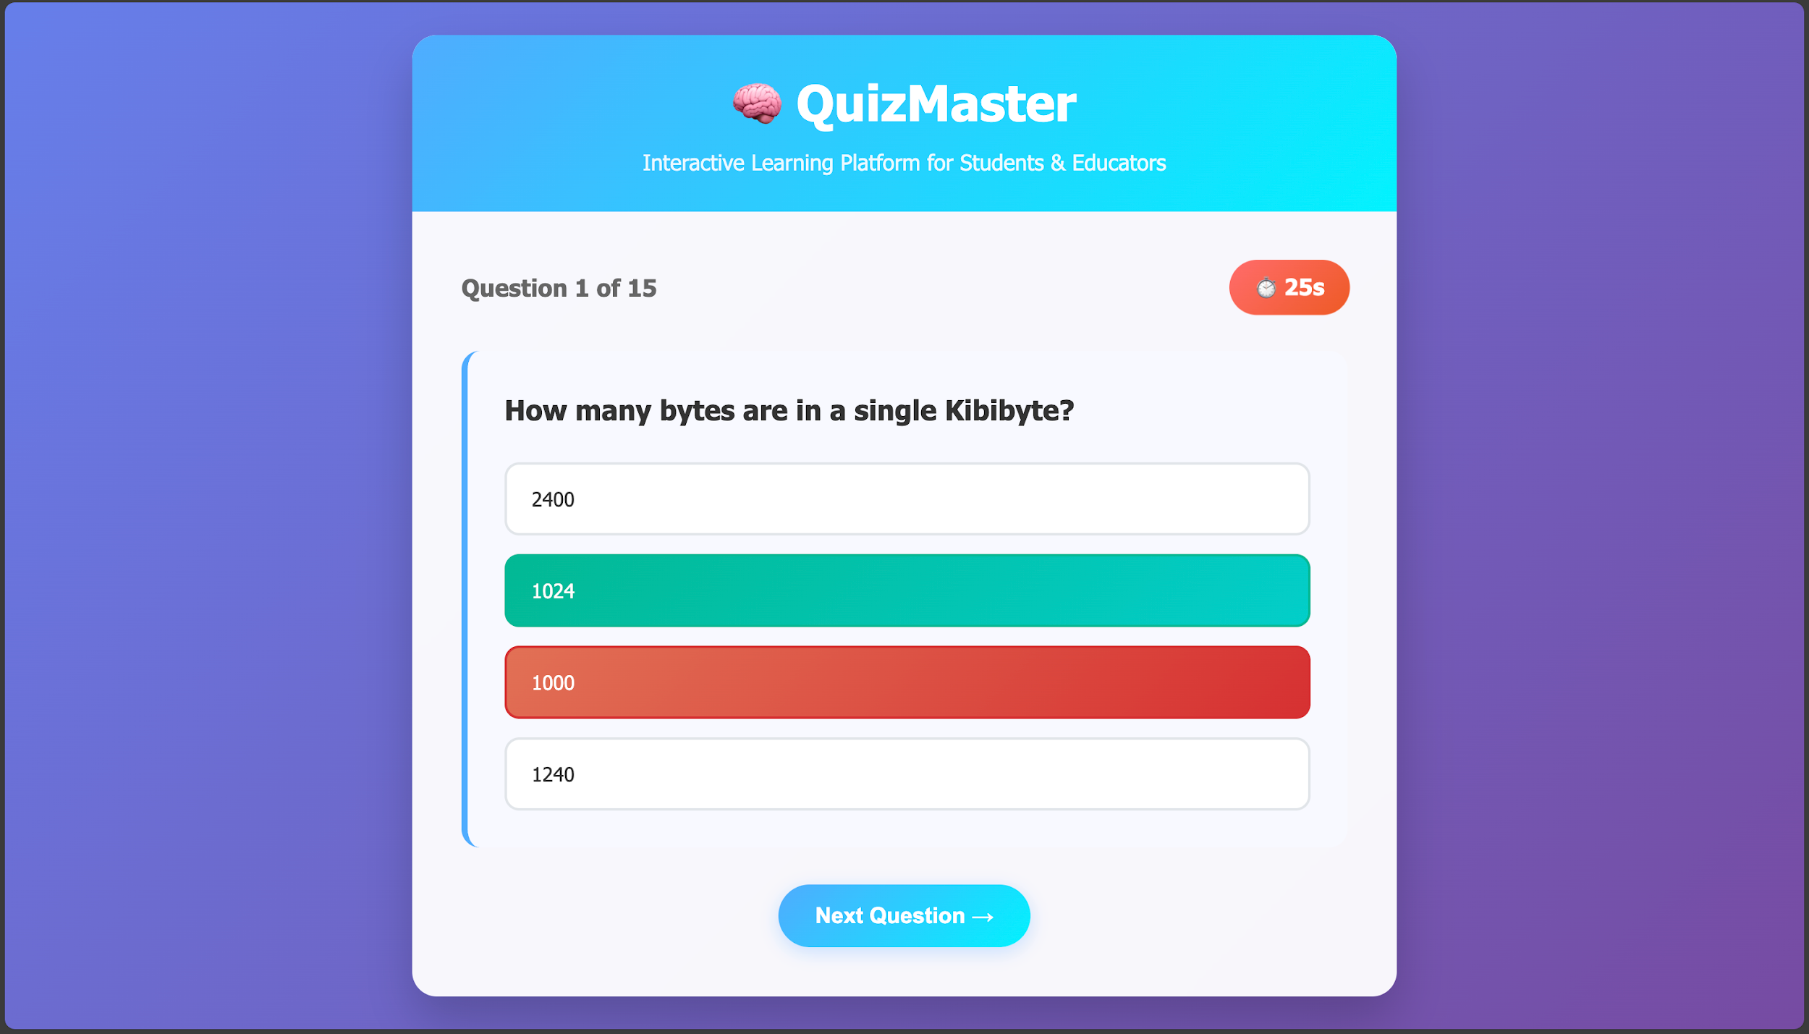
RESULT
7. Read Question and Choose Correct Answer!

Slide 14
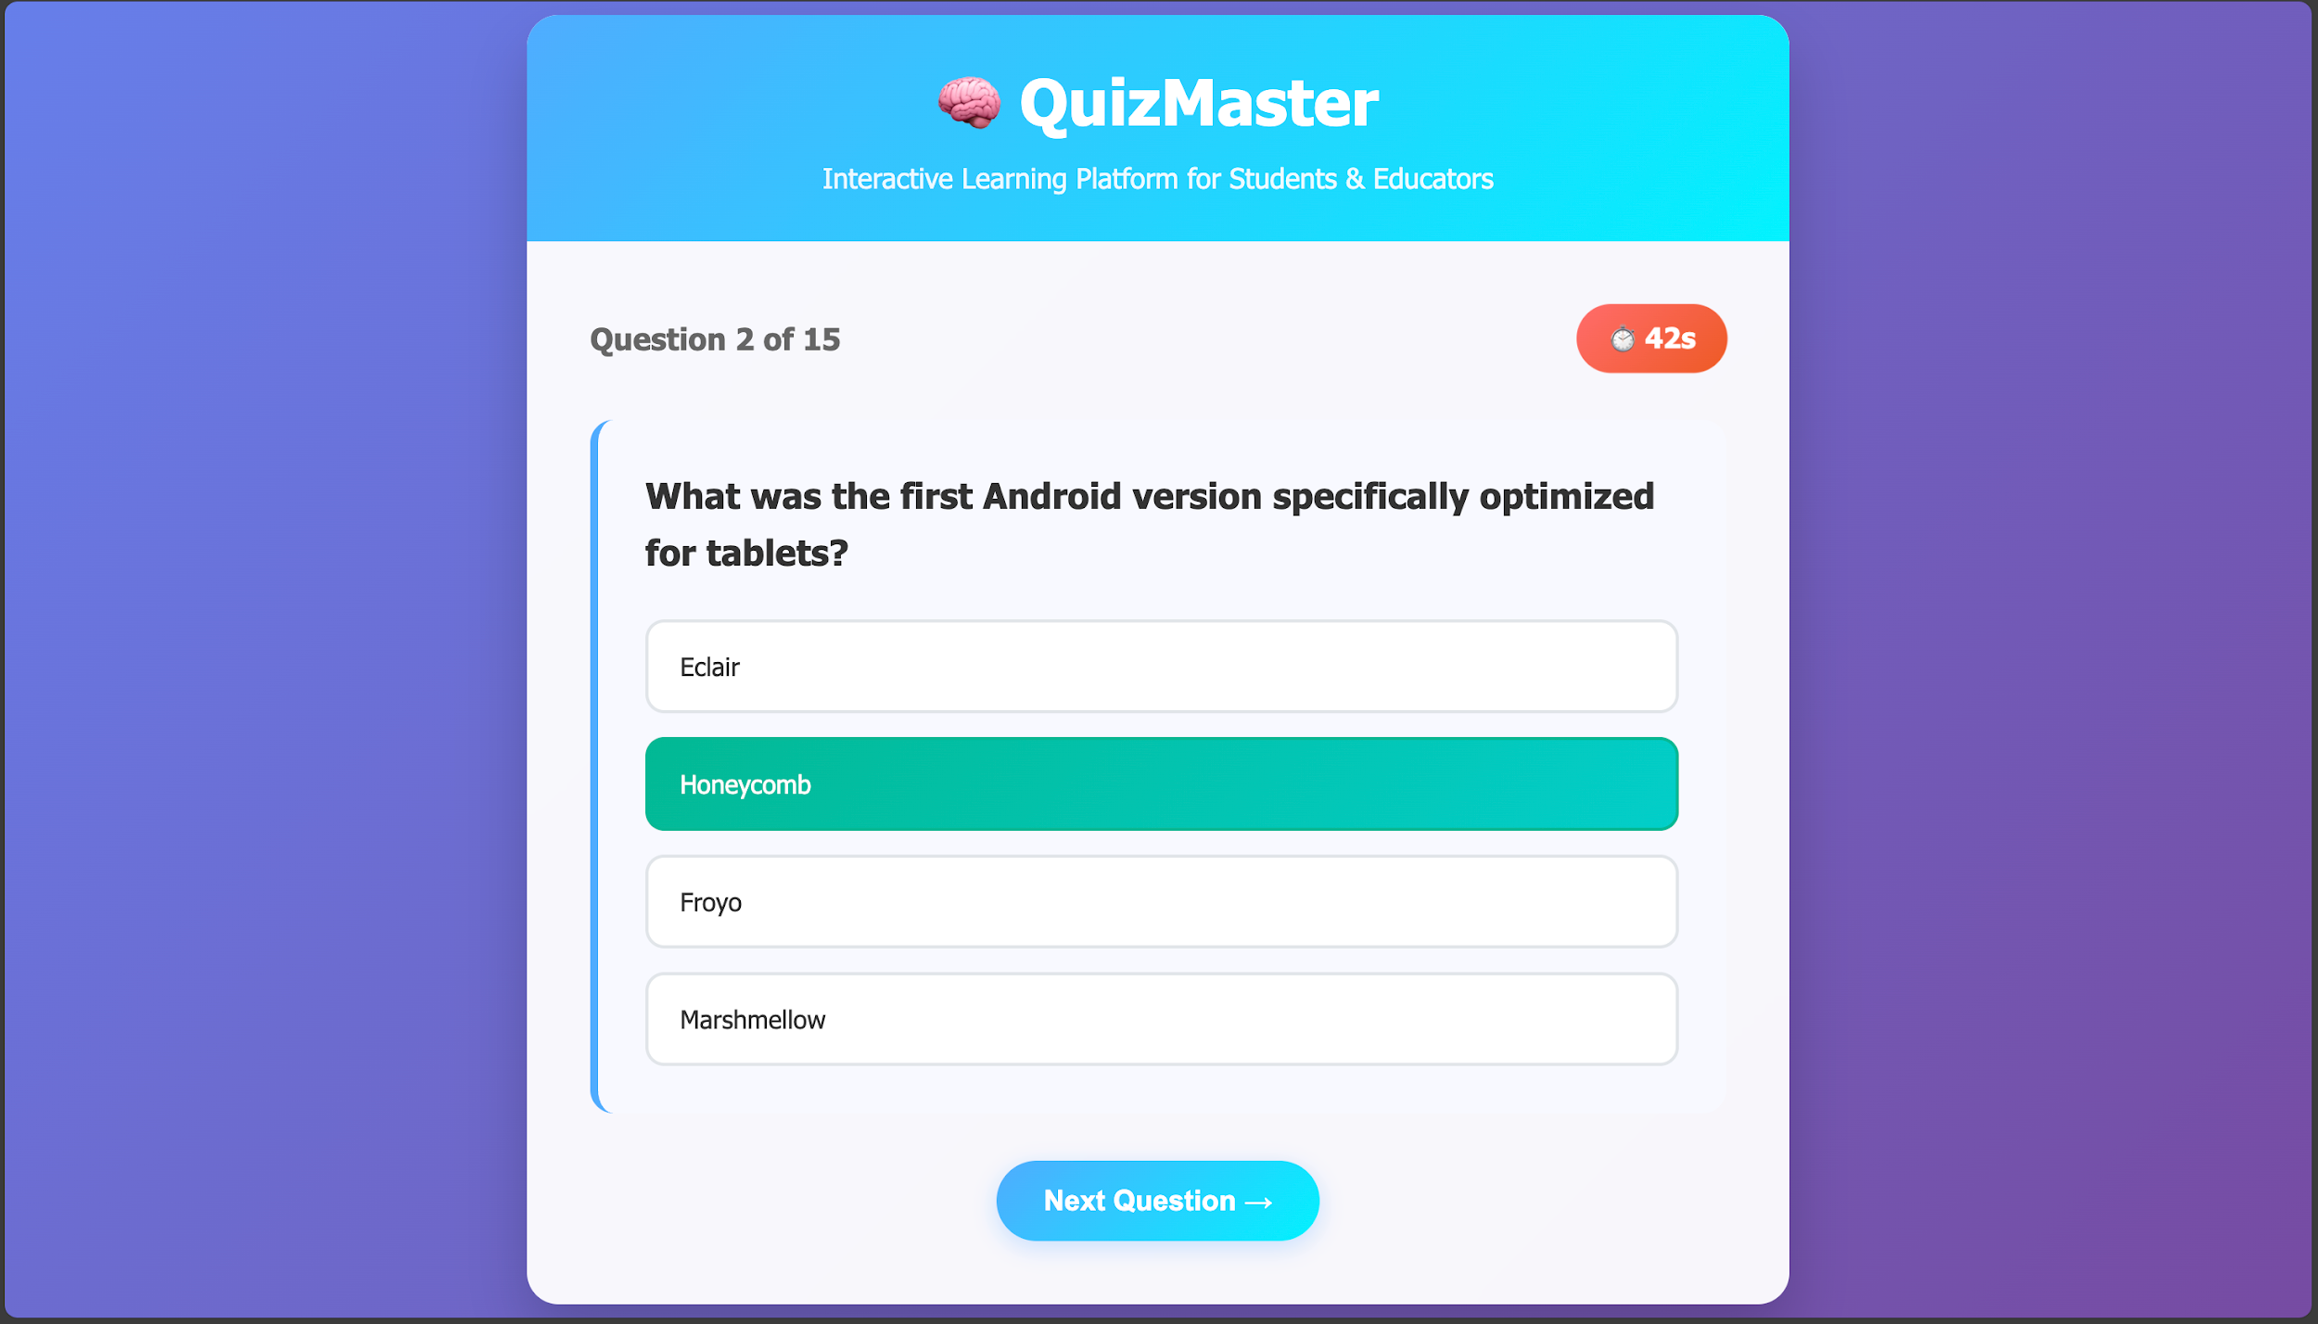
RESULT
8. Correct Answer are Marked Green!

Slide 15
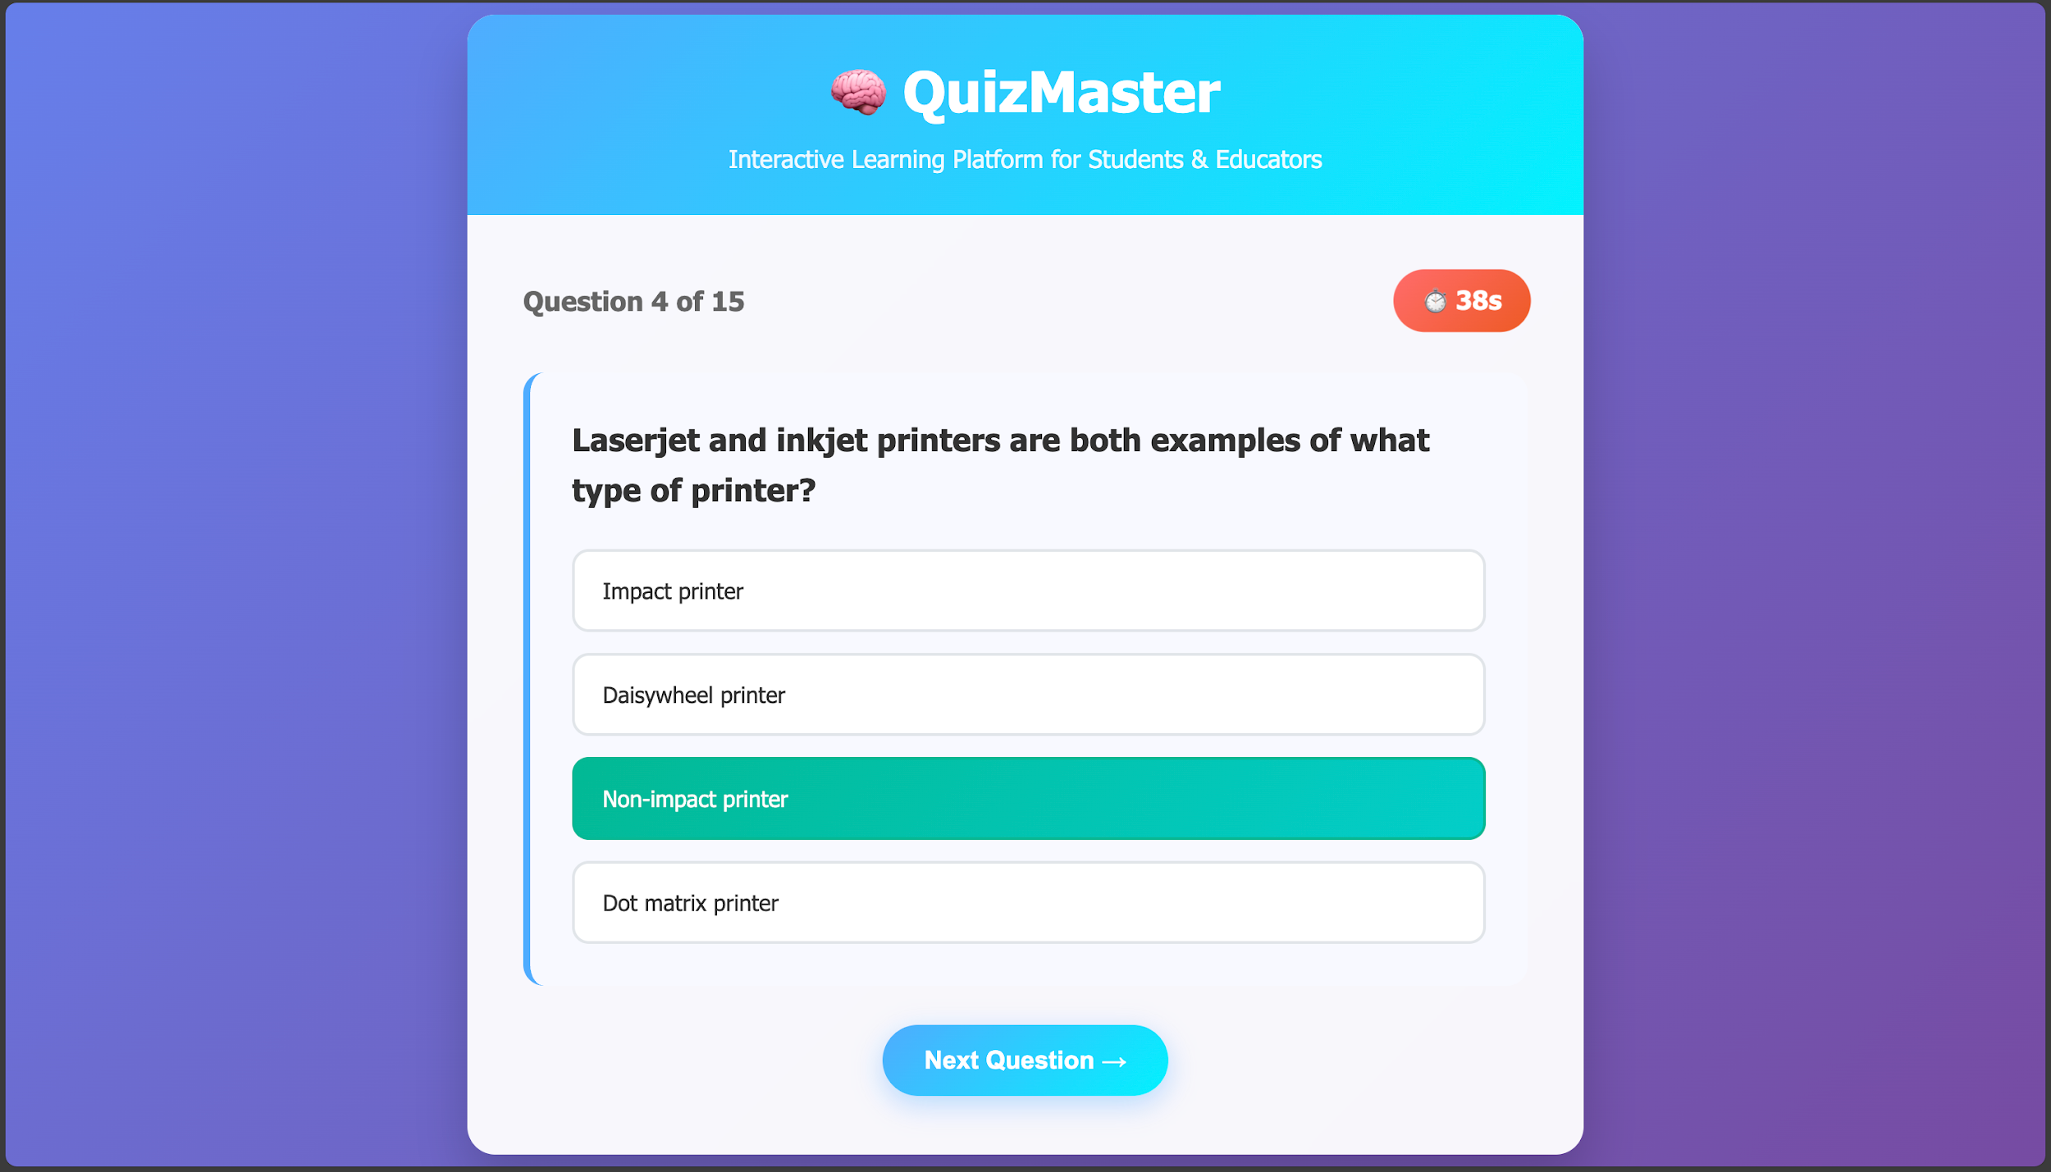
RESULT
9. Correct Answer are Marked Green!

Slide 16
RESULT
10. Inorrect Answer are Marked Red!

Slide 17
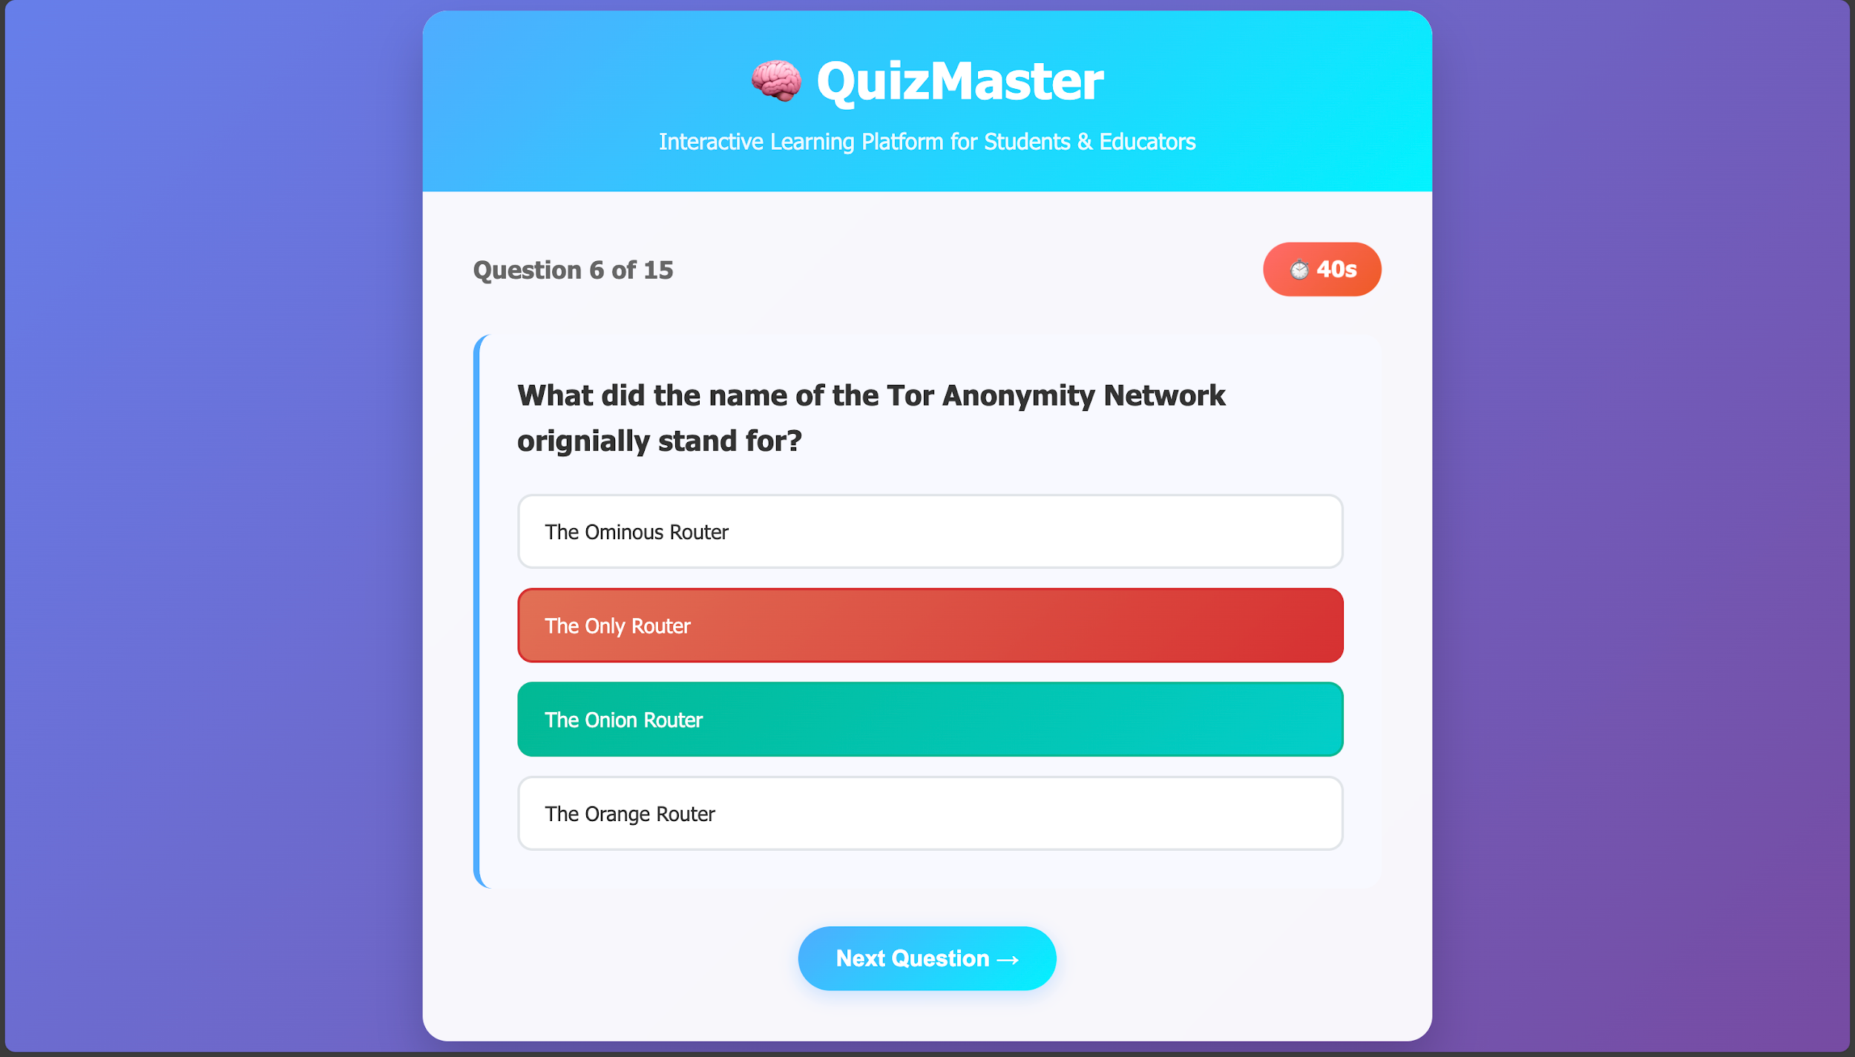
RESULT
11. Inorrect Answer are Marked Red!

Slide 18
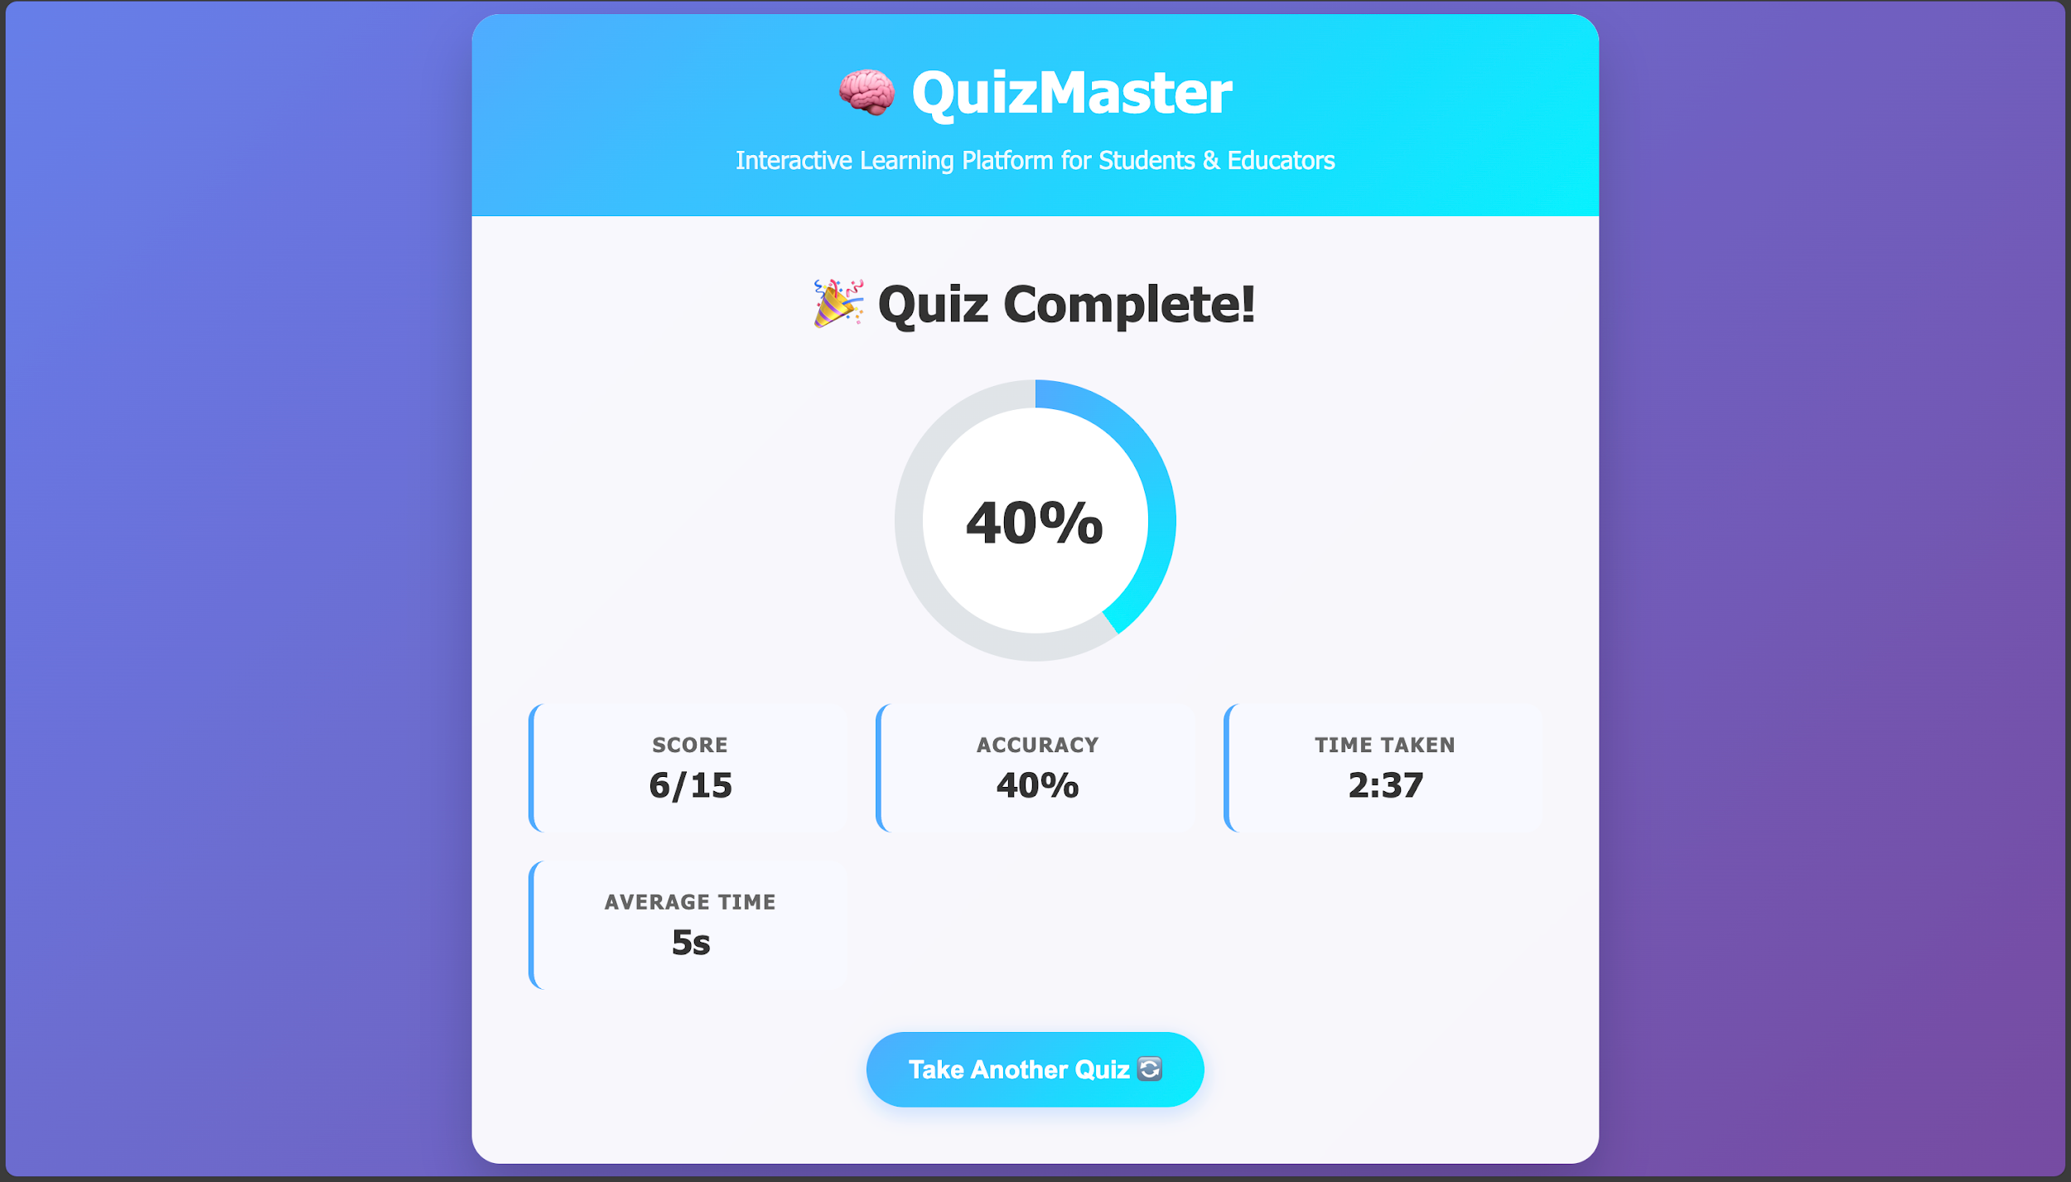
RESULT
12. Final Quiz Analytics are Shown to the User with Various Different Measures

Slide 19
GITHUB AND DEPLOYMNET LINK
Github Link : https://github.com/Janmejay-Pandya01/IBM-FWD-INTERNSHIP-AICTE-EDUNET-FOUNDATION.git
Deployment link: https://janmejay-pandya01.github.io/IBM-FWD-INTERNSHIP-AICTE-EDUNET-FOUNDATION/

Slide 20
CONCLUSION
The Online Quiz Application provides a simple yet powerful platform for students and educators to engage in interactive learning.
It combines dynamic question generation, customizable settings, and real-time feedback to make quizzes more effective and enjoyable.
With its responsive design and modern UI/UX, the application ensures accessibility across devices.
The project successfully demonstrates skills in frontend web development, API integration, and user experience design.
Overall, it serves as a practical and efficient solution for practice, testing, and performance analysis in an educational setting.

Slide 21
FUTURE SCOPE
Leaderboard & Multiplayer Mode → Introduce competitive quizzes with real-time ranking.
Backend Integration → Store user data, quiz history, and performance analytics.
Advanced Analytics Dashboard → Provide deeper insights using charts and progress trends.
Offline Support → Enable quizzes without internet connectivity.
Custom Question Bank → Allow educators to add/upload their own sets of questions.
Gamification Features → Add badges, rewards, and levels to boost engagement.

Slide 22
REFERENCES
1. Open Trivia Database (OpenTDB) – https://opentdb.com (Quiz Questions API)
2. MDN Web Docs – https://developer.mozilla.org (Authoritative JavaScript, HTML5, and CSS documentation)
3. W3C Web Standards – https://www.w3.org (Web accessibility and standards compliance)
4. Smashing Magazine – https://www.smashingmagazine.com (Modern UI/UX design practices)
5. CSS Tricks – https://css-tricks.com (Advanced CSS techniques and responsive design)
6. FreeCodeCamp – https://www.freecodecamp.org (Frontend development tutorials and guides)

Slide 23
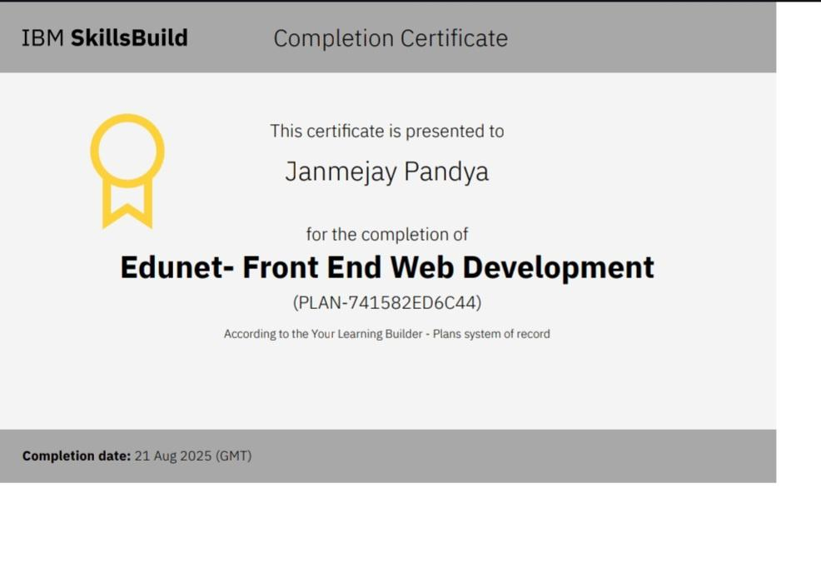
IBM Certifications:
Certificate: Edunet- Front End Web Development

Slide 24
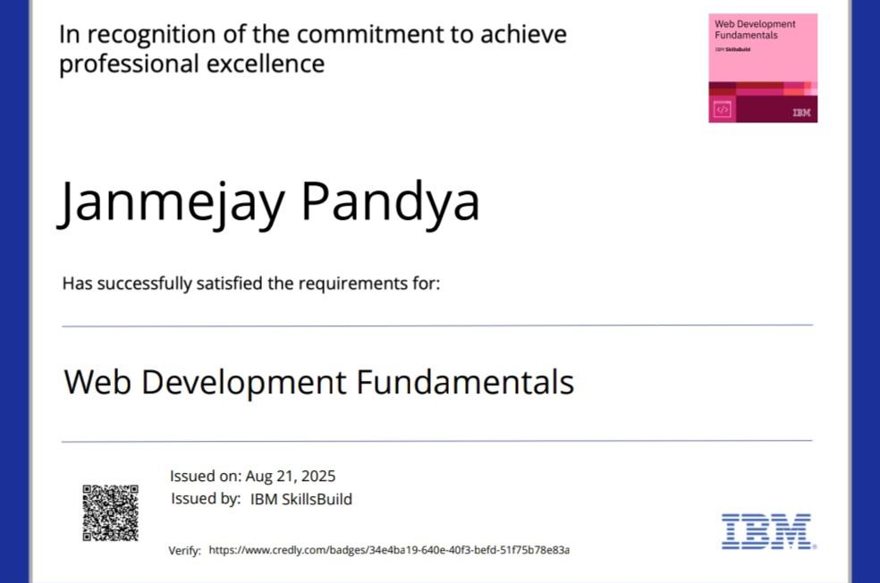
IBM Certifications:
Certificate with Creadly Badge: Web Development Fundamentals

Slide 25
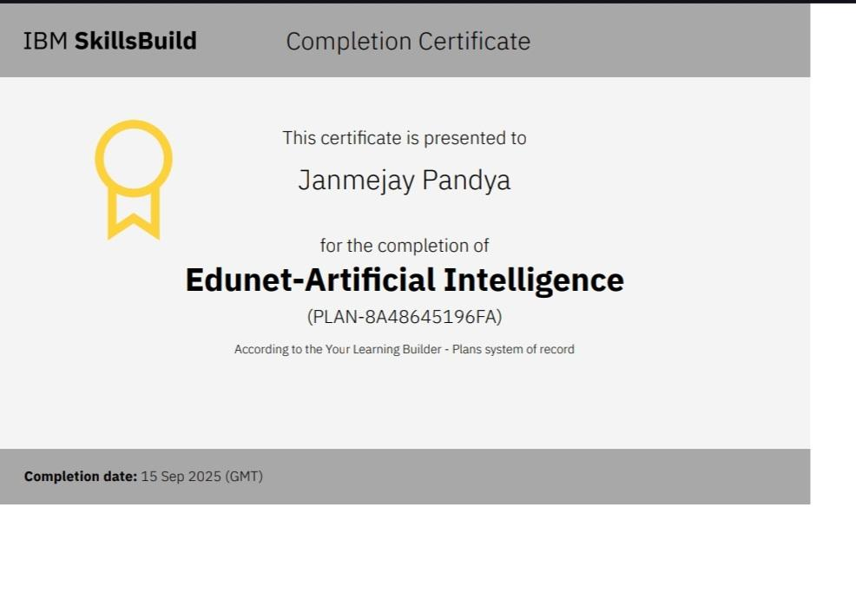
IBM Certifications:
Certificate: Edunet-Artificial Intelligence

Slide 26
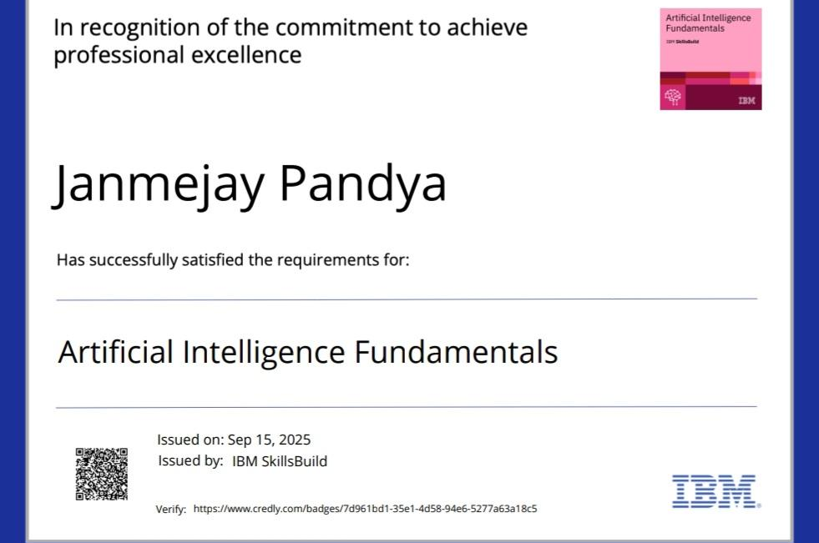
IBM Certifications:
Certificate with Creadly Badge: Artificial Intelligence Fundamentals

Slide 27
THANK YOU

